Slide 1
Dissemination of the project and it‘s results
Jūratė Jovaišienė
Joniskelio I. Karpio ZUPM, Lithuania

Slide 2
Tools of dissemination
School websites www.ikarpis.joniskelis.lm.lt and www.ikarpis.lt;
School Facebook group „I.Karpio ŽŪPM aktyvas“ https://www.facebook.com/groups/277036195716219/;
Publication in local newspaper;
Using the information stands of the project.

Slide 3
Publications in school website
We published 5 acticles about the project, project results and activities in the school website:
  1. International partnership project „School sweet school (November 2015); https://ikarpis.joniskelis.lm.lt/mokykla/projektai.htm
  2. International project „School sweet school“ (2016) http://www.ikarpis.lt/projektine-veikla/tarptautinis-projektas-mokykla-miela-mokykla
  3. Meeting in Lithuania of international schools partnership project „School sweet school“ (2017) http://www.ikarpis.lt/naujienos/renginiai/2017/04/tarptautinio-tarpmokykliniu-partnerysciu-projekto-mokykla-miela-mokykla-susitikimas-lietuvoje

Slide 4
Publications in school website
Publications in school website:
  4. International schools partnership project „School sweet school“, meeting in Romania (2017) http://www.ikarpis.lt/naujienos/renginiai/2017/05/tarptautinio-tarpmokykliniu-partnerysciu-projekto-mokykla-miela-mokykla-dalyviu-susitikimas-rumunijoje
  5. Students exchange visit in Turkey (2017) http://www.ikarpis.lt/naujienos/renginiai/2017/06/mokiniu-mainu-vizitas-turkijoje

Slide 5
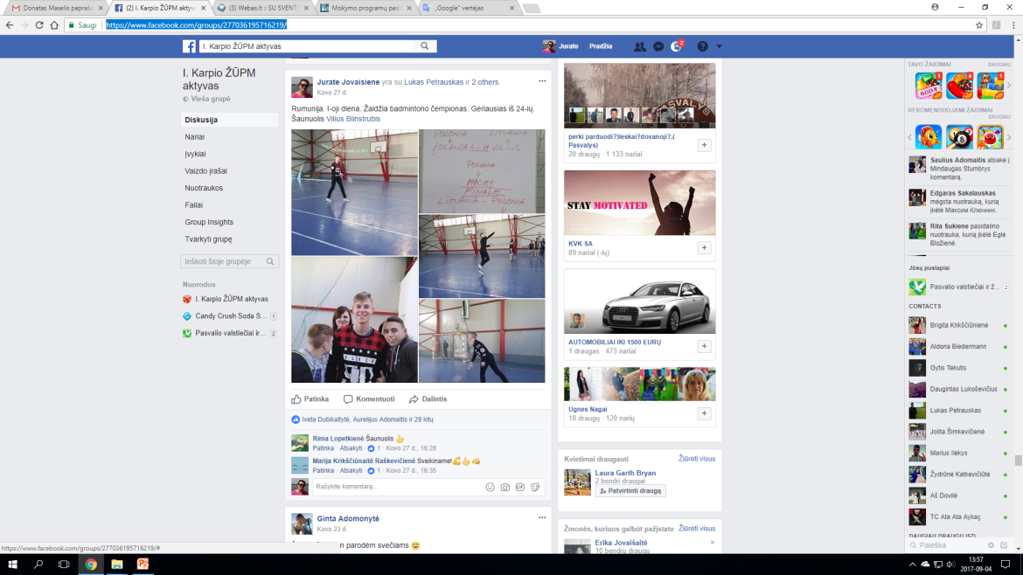
Facebook group „I. Karpio ŽŪPM aktyvas“
A lot of publications in Facebook group „I. Karpio ŽŪPM aktyvas“ since beginning of the project: https://www.facebook.com/groups/277036195716219/

Slide 6
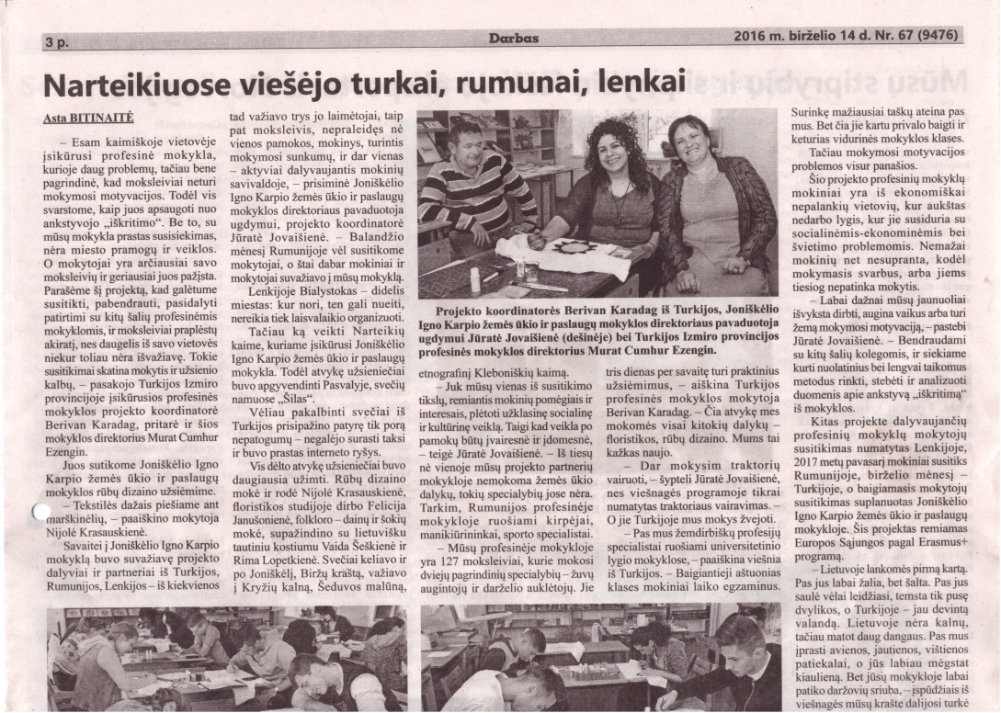
An article in local newpaper „Darbas“ (1)

Slide 7
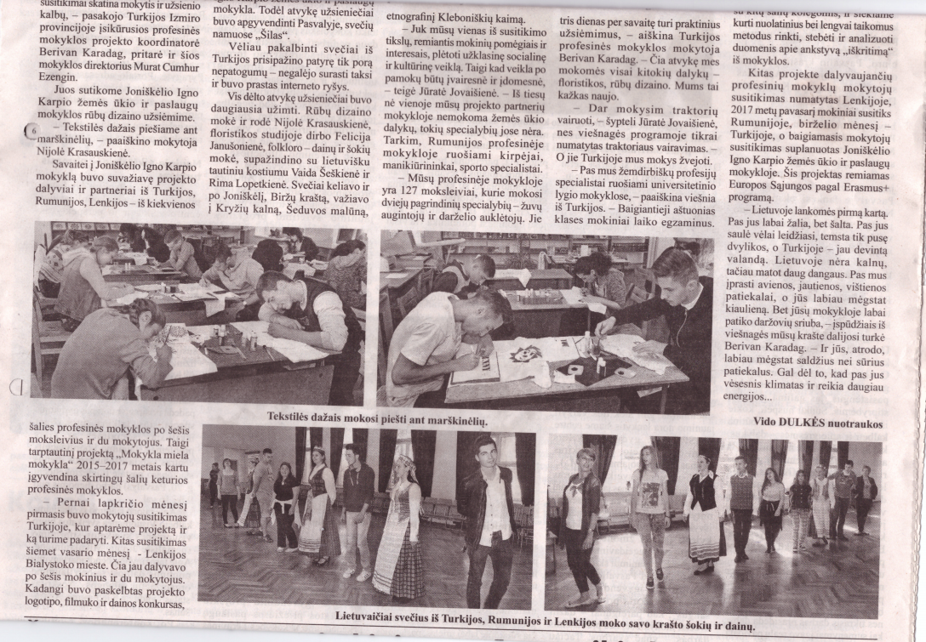
An article in local newpaper „Darbas“ (2)

Slide 8
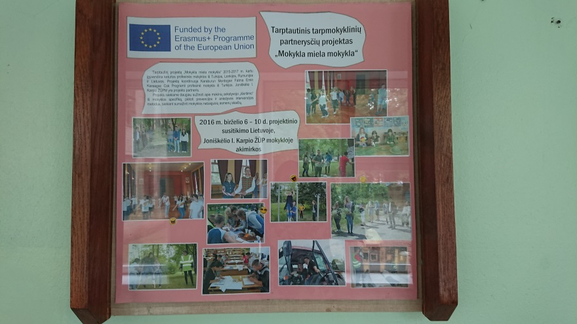
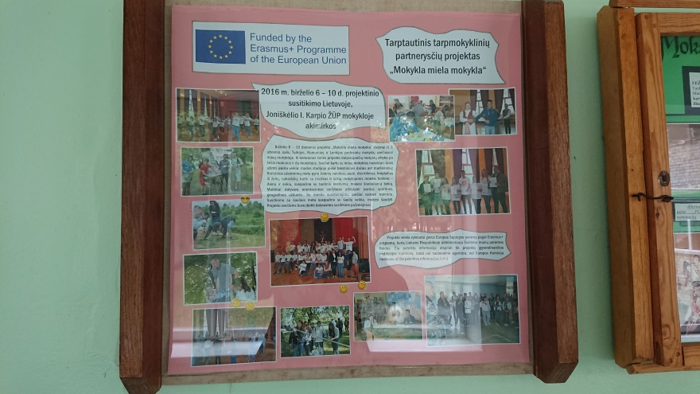
Using the information stands of the project (1)

Slide 9
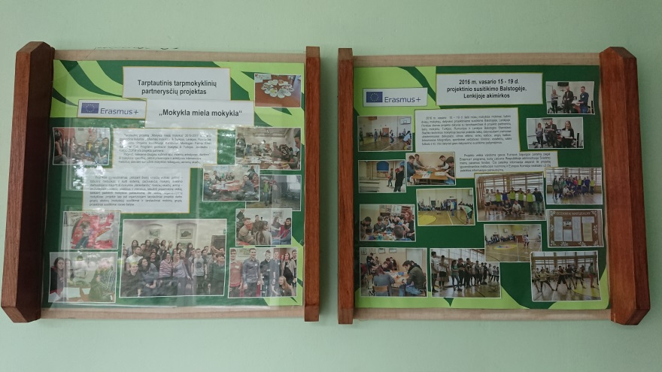
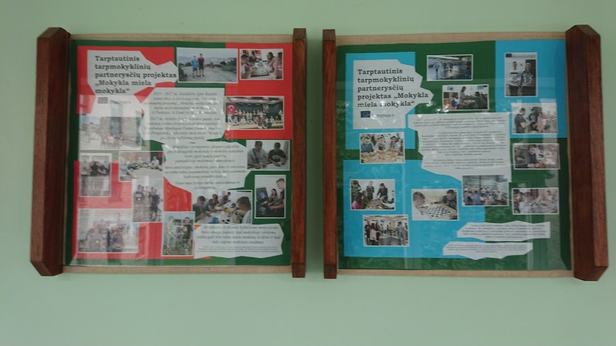
Using the information stands of the project (2)

Slide 10
Thank you for your attention!
This project has been funded with support from the European Commission. This publication (communication) reflects only the views only of the author, and the Commission cannot be responsible for any use which may be made of the information contained therein.

